Slide 1














Project presentation
Presented by Fathur Imam Mujaddid

Slide 2

Origin of the creative idea
Objective: To develop an accurate disease prediction system to assist in early diagnosis and health management.
Benefits: Enhancing awareness and prevention of diseases, providing valuable information to healthcare providers.

Slide 3
01.
Diabetes: Support Vector Classifier (SVC) - Separates classes with an optimal decision boundary.
Comprehensive Description of the Model
02.
Heart Disease: Logistic Regression - A probabilistic model for binary classification.
Each model is selected based on the characteristics of the data and the type of disease being predicted. For the machine learning model, I refer to the machine learning map from scikit-learn
Pneumonia: ResNet18 - A deep CNN architecture for classifying X-ray images.
03.

Slide 4


Slide 5




Model Efectiveness
Diabetes Prediction
Heart Disease Prediction
Pneumonia Prediction

Slide 6
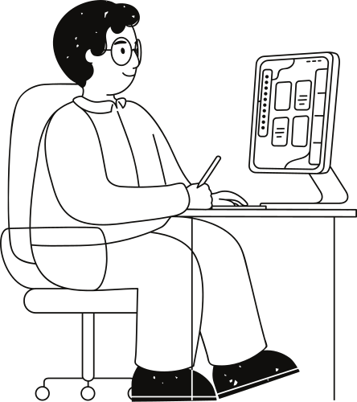
Overview of Dataset
Dataset : Diabetes Prediction
Source: https://www.kaggle.com/datasets/uciml/pima-indians-diabetes-database
The datasets consist of several medical predictor (independent) variables and one target (dependent) variable, Outcome. Independent variables include the number of pregnancies the patient has had, their BMI, insulin level, age, and so on.

Slide 7
Overview of Dataset
Dataset : Heart Disease Prediction
Source: https://www.kaggle.com/datasets/uciml/pima-indians-diabetes-database
This data set dates from 1988 and consists of four databases: Cleveland, Hungary, Switzerland, and Long Beach V. It contains 76 attributes, including the predicted attribute, but all published experiments refer to using a subset of 14 of them. The "target" field refers to the presence of heart disease in the patient. It is integer valued 0 = no disease and 1 = disease.

Slide 8
Overview of Dataset
Dataset : Pneumonia prediction
Source: https://www.kaggle.com/datasets/paultimothymooney/chest-xray-pneumonia
The dataset is organized into 3 folders (train, test, val) and contains subfolders for each image category (Pneumonia/Normal). There are 5,863 X-Ray images (JPEG) and 2 categories (Pneumonia/Normal).
For the analysis of chest x-ray images, all chest radiographs were initially screened for quality control by removing all low quality or unreadable scans. The diagnoses for the images were then graded by two expert physicians before being cleared for training the AI system. In order to account for any grading errors, the evaluation set was also checked by a third expert.

Slide 9
Methodology
01
02
03
04
Data Collection: Gathering the dataset from relevant sources
Data Exploration: Conducting statistical analysis and visualizations to understand the data.
Model Training: Splitting the data into training and testing sets, training the model with hyperparameter tuning.
Evaluation: Measuring model performance and comparing it to the baseline.

Slide 10
Challenges Faced and Learnings
Challenges:
Data Limitation for Diabetes Prediction: The dataset for diabetes prediction was limited in size, making it difficult to train a highly accurate model. This required careful feature selection and data balancing techniques to avoid overfitting.
High Computational Requirements for Image Data: Processing large image datasets, such as X-rays, requires significant GPU power. The dataset size (around 45 GB) presented a challenge due to hardware limitations, necessitating optimization techniques.
Initial Plan for Multi-Disease Classification: Initially, the goal was to classify around 15 diseases from the X-ray data. However, due to the dataset's size and computational constraints, the focus was narrowed down to pneumonia classification only.
Learnings:
The importance of good data preprocessing and selecting a model appropriate for the data.

Slide 11
Suggestions for Future Improvements
Model Enhancements:
Transfer Learning for X-ray Classification: To improve pneumonia detection, applying transfer learning from pre-trained models on larger medical datasets could lead to better performance without requiring extensive computational resources.
Expansion to Other Diseases:
Multi-Disease X-ray Classification: Revisiting the original plan to classify 15 diseases from the X-ray dataset could be a major future improvement. Using advanced models like DenseNet or EfficientNet could handle the complexity of multiple disease classification while maintaining accuracy.
Disease Types to Include:
Tuberculosis: A major respiratory disease detectable through X-ray images.
COVID-19: Adding the capability to identify COVID-19 pneumonia could be valuable, especially with available pandemic data.
Lung Cancer: Expanding to detect early signs of lung cancer would increase the model’s utility in critical diagnoses.
Emphysema and other chronic respiratory conditions.
Real-World Application:
Web or Mobile Application: Developing a user-friendly platform where healthcare providers can upload patient data or X-ray images for real-time predictions would make the model more accessible in clinical settings.
Cloud Computing for Scalability: Leveraging cloud-based GPUs (e.g., AWS, Google Cloud) could allow the model to scale up and handle larger datasets for multi-disease predictions.

Slide 12
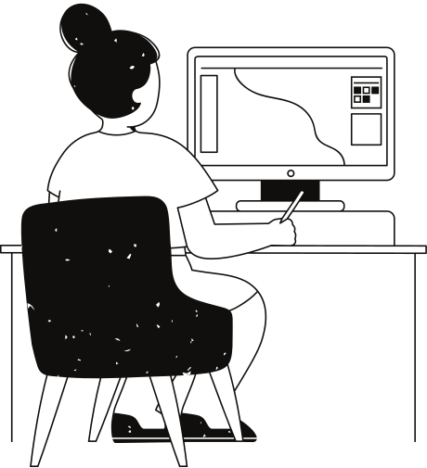
Demo of the Model
Demo link:
https://huggingface.co/spaces/fathurim/Multiple_Disease_Prediction_System_streamlit
Drive link:
https://drive.google.com/drive/folders/1-H36zp9flkMVhLKMFTbz1D6w9ooz7tJH?usp=sharing

Slide 13
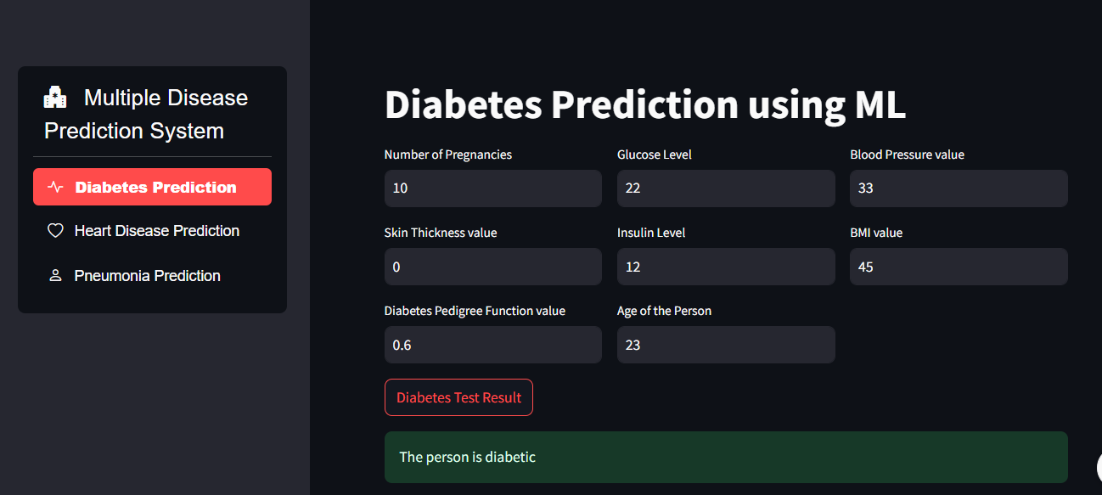

Slide 14
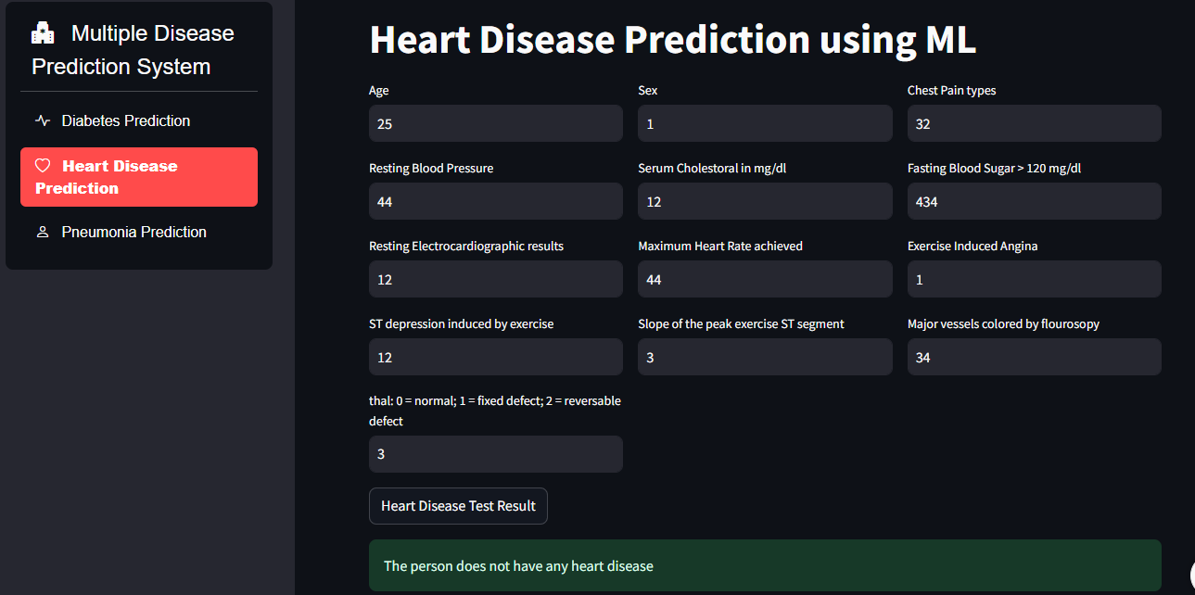

Slide 15
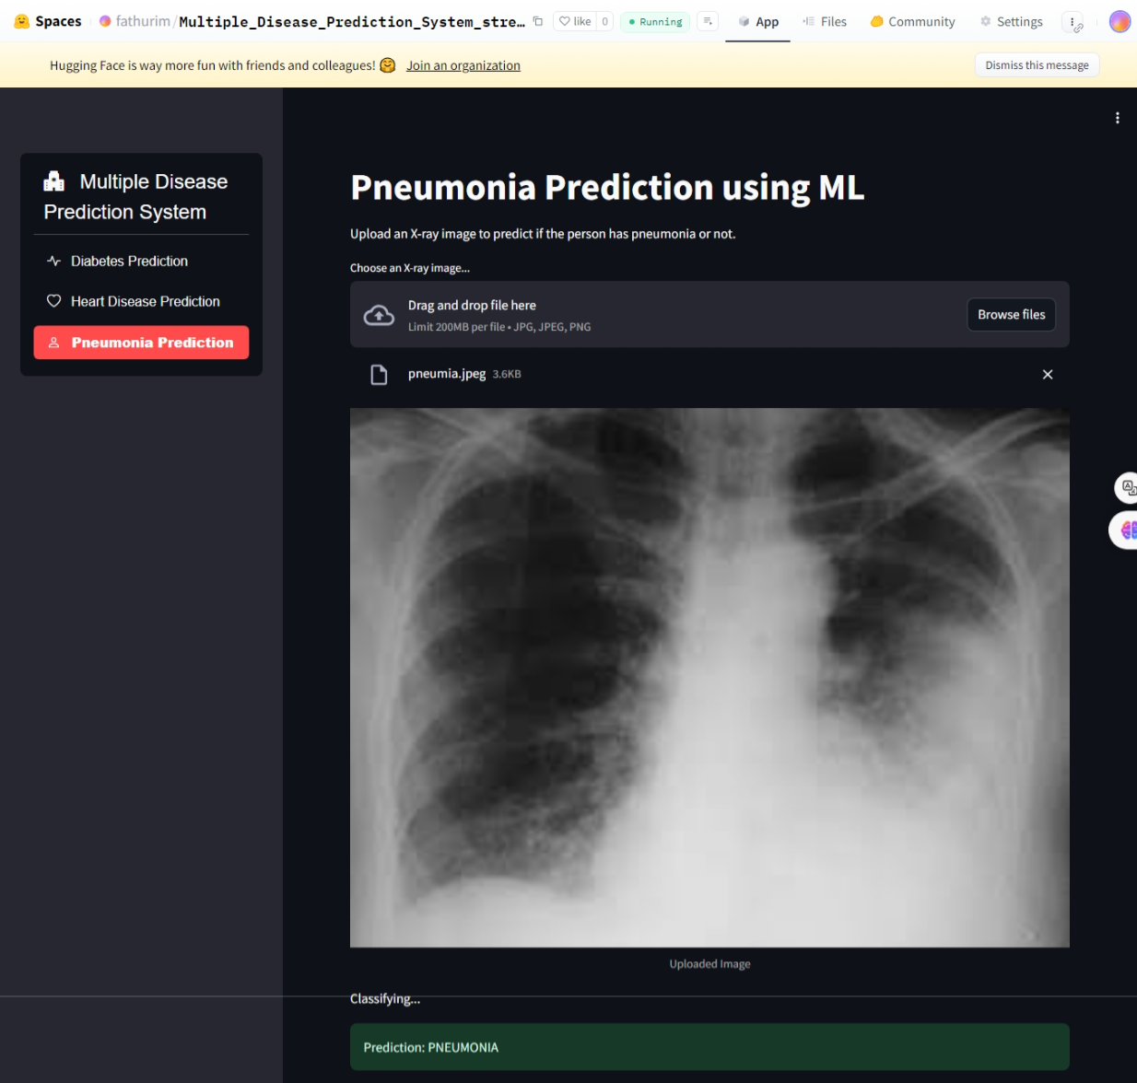

Slide 16
Thank you very much!

